Slide 2
Administrative Enhancements
Microsoft Project 2010 Ignite

Slide 3
Agenda
Departments
Delegation
Project Manager Provisioned Permissions
Active Directory Synchronization
Bulk Update Project Sites

Slide 4
Departments

Slide 5
Departments
Department is a pre-defined custom field with an empty lookup table in Project Server 2010
Primary purpose is to act as a filter for Projects, Resources, their Custom Fields, Enterprise Project Types (EPT) and Drivers
Controls what entities appear to user within given areas of Project Professional and Project Web App
Also enable filtering of what data is included in an OLAP database

Slide 6
Departments are Not a Security Feature!
Departments help EPM Administrators tailor the PWA experience to different sets of users
Filtering out items like Enterprise Project Types (EPTs) and Custom Fields from the PWA UI on a user by user basis helps prevents the UI from becoming overcrowded with too many choices
Helps keep a PWA instance more user-friendly when there are larger numbers of users and groups in PWA
Notes:
PWA = Project Web App
EPT = Enterprise Project Type

Slide 7
Departmental Custom Fields
Allows different departments to have their own set of custom fields
Custom fields not assigned to departments are global in scope
Users can see both global and departmental custom fields
Department Custom Field can be hierarchical, but there is no inheritance between levels - only fields defined at the exact level and global will be filtered

Slide 8
Associating Departments to Custom Fields
Provides EPM Administrator a technique for focusing sets of custom fields for different groups in the organization
Users with different department associations will see only their custom fields
Projects associated with different departments will only show their custom fields

Slide 9
Associating Resources with Departments
PWA User accounts now have an available setting for Departments
Set a user’s Department to focus that user’s visibility to custom fields to just that Department's custom fields and any globally scoped custom fields
Notes:
PWA = Project Web App

Slide 10
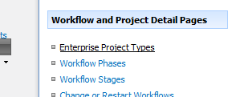
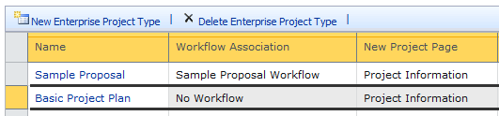
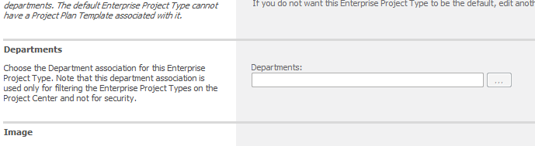
Associating Projects to Departments
Departments can focus a user on what types of projects they can create
Accomplished by associating Enterprise Project Types with a Department
Users will only have the option of creating projects based on the Enterprise Project Types that are associated with their Department
More on EPT’s in the Demand Management module

Slide 11
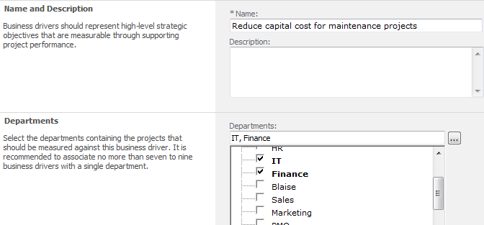
Associating Drivers to Departments
Drivers are used during the demand management and portfolio analysis processes to decide on project prioritization
Drivers are either global or associated with one or more departments
A driver prioritization can be associated with a department
No inheritance for hierarchical department structures

Slide 12
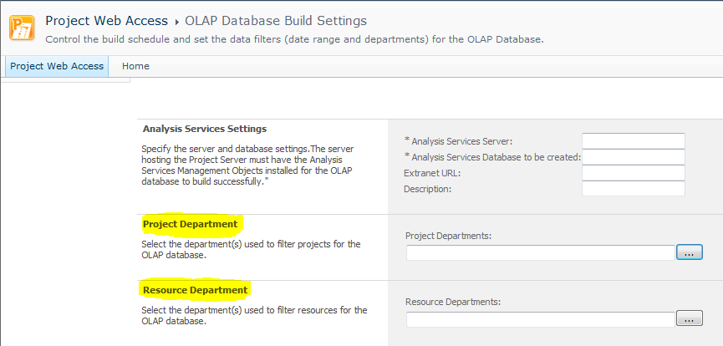
Departmental OLAP Databases
More on this in Reporting Module …

Slide 13
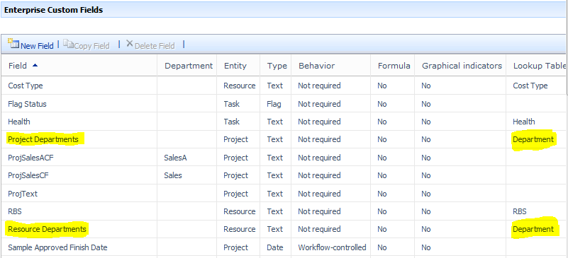
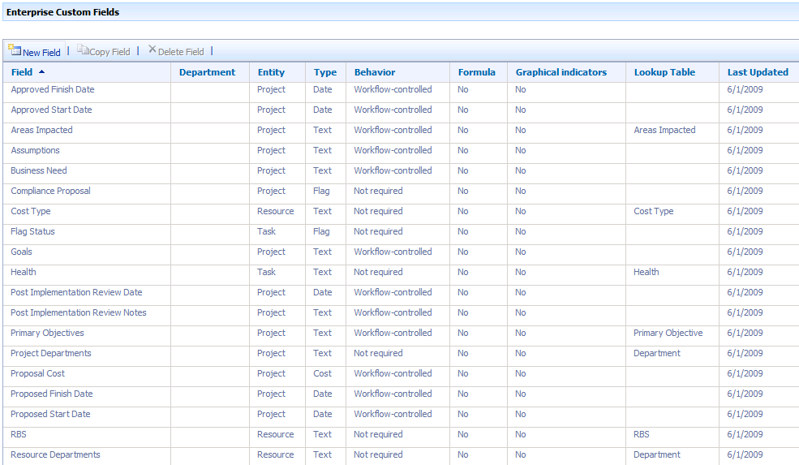
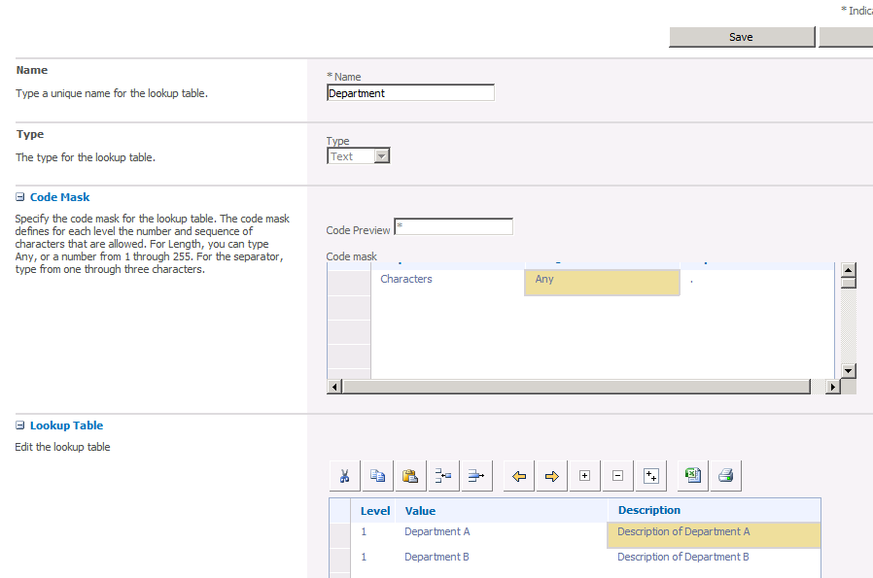
Departments
Pre-defined Custom Fields and Lookup table
Project Server 2010 has built-in awareness of Departments

Slide 14
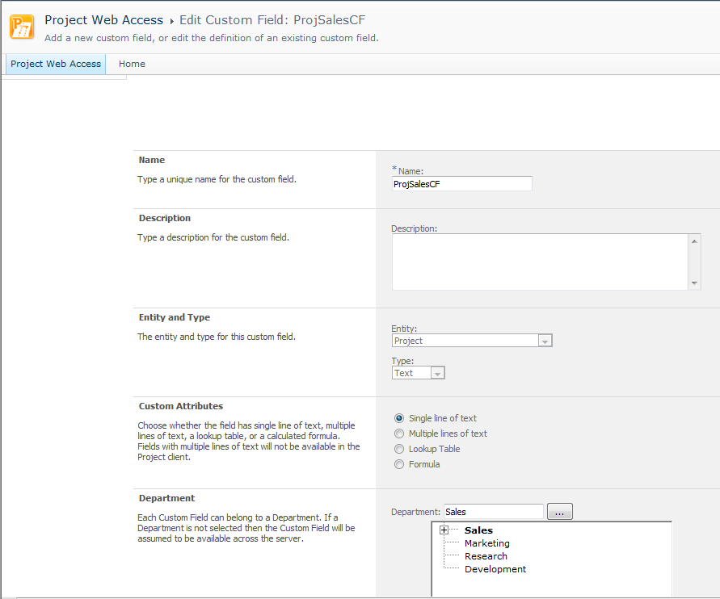
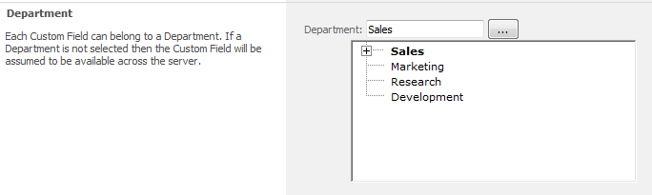
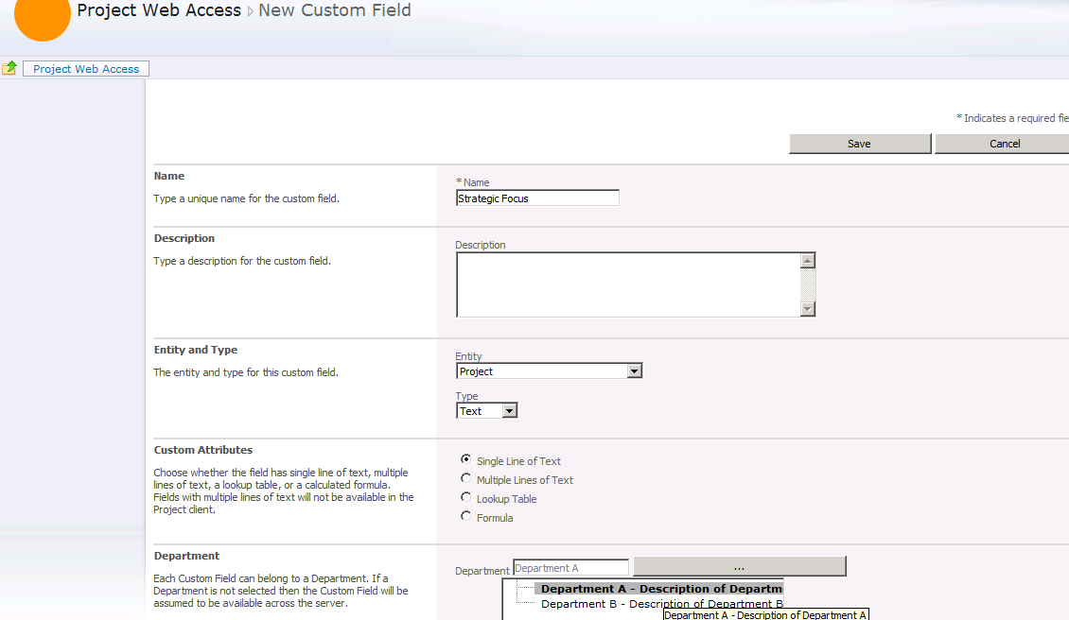
Departmental Custom Fields
Custom Fields can be assigned to specific departments

Slide 15
Deployment Consideration
With the new filtering and PWA UI tailoring functionality provided by Departments in Project Server 2010, organizations that previously required multiple PWA instances to support different groups may be able to consolidate into fewer PWA 2010 instances
Benefits
Reduced Administration by managing fewer instances of PWA
Potential hardware cost savings

Slide 16
DEMO
Departments
Notes:
Create/edit department lookup table
Associate resources & projects with departments
Associate EPTs and Custom fields with departments
Associate drivers with departments
Show example of departmental OLAP

Slide 17
Delegation

Slide 18
User Delegation Overview
Allows one user to delegate duties to another user, regardless of permission level differences between the users
Example: Team Member can be delegate for an Administration
The user delegation feature in Project Web App can be enabled or disabled globally for all users and groups
By default, the delegates feature is turned on globally, but the feature has not been enabled for any user or group except for administrators
Once you enter delegate mode, Project Server 2010 switches your security context to be the same as the person you are the delegate for

Slide 19
User Delegation Details
Scope of Delegation
Delegate has all Project Server 2010 access of the person being delegated (example: A team member acting as a delegate of an administrator will have all access of the administrator)
Does not include SharePoint access
Delegate accesses SharePoint Server team sites ( Risks, Issues, Deliverables, Documents ) with their own access rights and not those of the person being delegated
Auditing
SharePoint Unified Logging Service (ULS) logs contain details about User Delegation Activities
Reporting
There is no reporting available within PWA to show you, for example, when a user started and stopped a delegate session. The Unified Logging Service (ULS) log does, however, have entries to show you this sort of detail
Notes:
What should you be aware of?
Elevation of permissions
You forget you’re acting as someone else
Users cannot Manage Delegates when they are acting as a delegate. This is a security feature to prevent users from elevating their priviledges

Slide 20
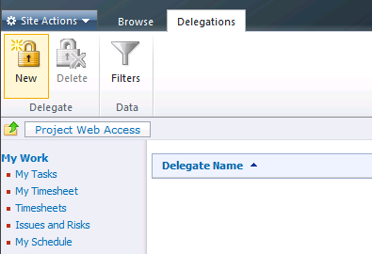
User Delegation Management
Delegation management from the individual PWA user perspective and the administrator perspective:
PWA Use Perspective
Project Web App -> Personal Settings -> Manage Delegates
Project Web App -> Personal Settings -> Act as Delegate
Project Web App -> Server Settings -> Security -> Manage Delegates
Notes:
Delegation management from the PWA user perspective and the administrator perspective

Slide 21
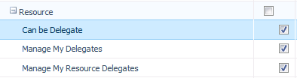
Delegation Management
Related security settings:
Manage My Resource Delegates Select this check box to enable users to set up delegations for other users
Manage My Delegates Select this check box to enable users to create delegations for themselves
Can be Delegate Select this check box to enable users to actively become a delegate for another user, after a delegation has been created

Slide 22
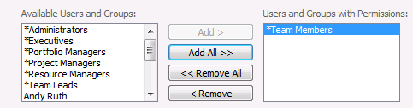
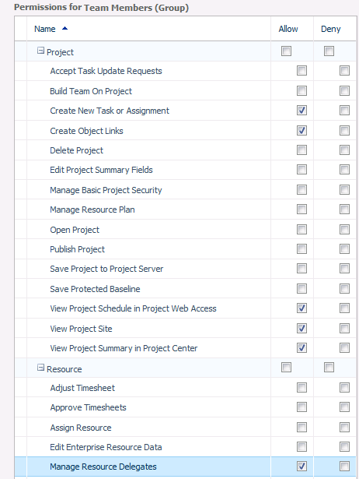
Delegation Management Ctnd.
Categories are used to determine which users or groups can have delegates do work on their behalf
In order for a delegation to work properly, the user requesting the delegation must have the correct category permissions, and the user who will act as the delegate must have the correct individual user or group permissions
Notes:
On the Quick Launch, click Server Settings.
Under Security, click Manage Categories.
Click the name of the category that contains the user or group for which you want to enable user delegation.
In the Users and Groups section, click the name of group or a specific user in the Users and Groups with Permissions box.
In the Permissions box that appears, scroll down to the Resource section, and select the check box for the Manage Resource Delegates permission to turn on the user delegation feature for that user or group.
Click Save to save the permissions on the server.

Slide 23
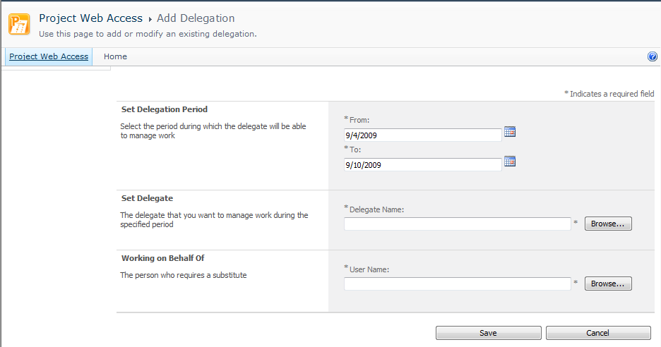
User Delegation
Add a Delegation

Slide 24
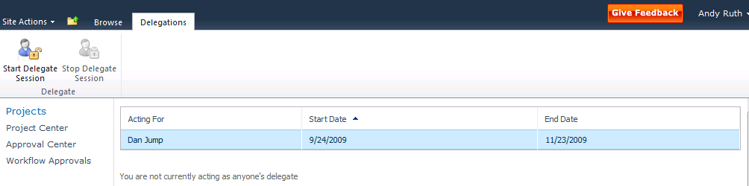
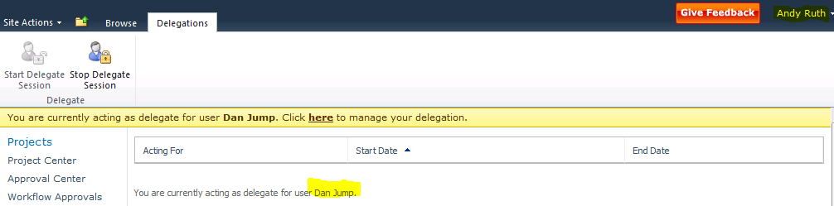
Activate a User Delegation Manually
Activate a delegate session outside of defined time
Project Web App -> Personal Settings -> Act as a Delegate -> Start Delegate Session

Slide 25
User Delegation Extensibility
Event Handlers
Pre Event
Post Event
Very easy to fulfill your custom auditing requirements
Plus plenty of methods to automate its managements
UserDelegationActivate | UserDelegationDeactivate
UserDelegationCreate | UserDelegationDelete

Slide 26
DEMO
Delegation
Notes:
Check global permissions related to delegation
Set permissions for a specific user:
On the Quick Launch, click Server Settings
Under Security, click Manage Users
Click the name of the user for which you are setting permissions
On the Edit User page, expand the Global Permissions section
Set permissions for a group:
On the Quick Launch, click Server Settings
Under Security, click Manage Groups
Click the name of the group for which you are setting permissions.
On the Add or Edit Group page, expand the Global Permissions section
In the Global Permissions section, under Resource, choose the appropriate permissions for this group

Slide 27
Changes to Project Server 2010 Permissions
Demand Management
Manage Portfolio Analyses (new)
Manage Prioritizations (new)
Manage Drivers (new)
Reporting
View Report Center Link (new)
View Data Analysis (removed)
Delegation
Can be Delegate (new)
Manage My Resource Delegations (new)
Manage My Delegations (new)
Manage Resource Delegations (new)

Slide 28
PROJECT MANAGER PROVISIONED PERMISSIONS

Slide 29
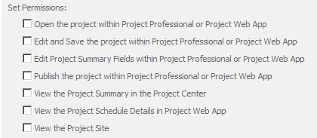
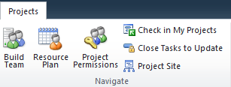
Project Manager Provisioned Permissions
Gives ability to enable a peer to modify/view your project without adding them to it
In Project Center a PM can set the permissions for a specific project
It acts like a single project category
Allows for PM control access, rather than Administrator

Slide 30
DEMO
PM Provisioned Permissions
Notes:
Go through steps of provision permissions for an individual (Barry Johnson) and a Group (Team Members) for a specific project (“Apparel ERP Upgrade”)
Log in as Andy Ruth and open a project
Add
Open the project …
View the Project Summary…

Slide 31
More Permission Changes
Project
Publish Project Summary (new)
New Project (updated)
Edit Project Summary Fields (updated)
Save Project to Project Server (updated)
No longer required
Create New Proposal or Activity (removed)
Download Project Web App Outlook add-in (removed)

Slide 32
Active Directory Synchronization

Slide 33
Active Directory Synchronization
Administrative UI is unchanged from 2007
But engineering work under the covers provide significant performance benefits
Consider re-evaluation of this feature for your requirements

Slide 34
BULK UPDATE PROJECT SITES

Slide 35
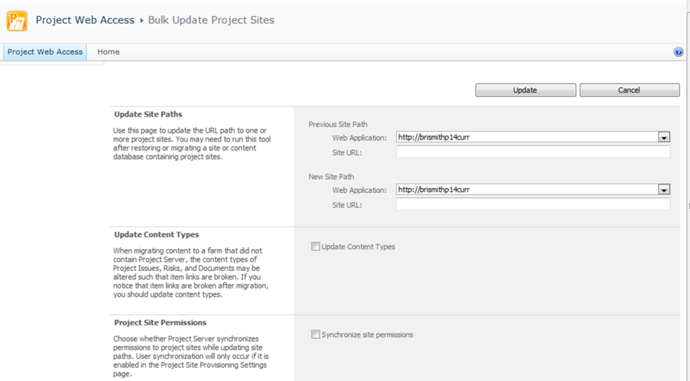
Bulk Update Project Sites
Server Settings -> Operational Policies -> Bulk Update Project Sites
Used to re-establish proper associations between data items in Project Server databases over to their associated data items in the project workspaces hosted in SharePoint

Slide 36
DEMO
Bulk Update Project Sites

Slide 37

- Resources
Product information and trial download
http://www.microsoft.com/project
Project Team Blog http://blogs.msdn.com/project
Interactive content - Videos & Sessions & Webcasts
http://www.microsoft.com/showcase/en/US/channels/microsoftproject
http://www.microsoft.com/events/series/epm.aspx
IT Professional related
TechCenter @ TechNet http://technet.microsoft.com/ProjectServer
Admin Blog http://blogs.technet.com/projectadministration
Developer related
Developer center @ MSDN http://msdn.microsoft.com/Project
Programmability blog http://blogs.msdn.com/project_programmability
Additional questions? Project 2010 Forums!
http://social.msdn.microsoft.com/Forums/en-US/category/projectserver2010,projectprofessional2010
SharePoint 2010
http://sharepoint.microsoft.com
FORUMS
Project Professional 2010
General Questions and Answers
Project Server 2010
General Questions and Answers
Setup, Upgrade, Administration and Operation
Customization and Programming

Slide 38
Summary
Project Server 2010 offers simplified administration and flexibility

Slide 39

© 2009 Microsoft Corporation. All rights reserved. Microsoft, Windows, Windows Vista and other product names are or may be registered trademarks and/or trademarks in the U.S. and/or other countries.
The information herein is for informational purposes only and represents the current view of Microsoft Corporation as of the date of this presentation. Because Microsoft must respond to changing market conditions, it should not be interpreted to be a commitment on the part of Microsoft, and Microsoft cannot guarantee the accuracy of any information provided after the date of this presentation. MICROSOFT MAKES NO WARRANTIES, EXPRESS, IMPLIED OR STATUTORY, AS TO THE INFORMATION IN THIS PRESENTATION.

